Slide 2
Data Types
Data Type
determines the kind of information that a column can store
determines the type of operations that can be done on that data

Slide 3
Data Types
Categories of Data Types
Character
Stores a string of one or more characters
Characters meaning letters, numbers, symbols, or special characters
Numeric
Stores numbers which are used for mathematical calculations
Can store integers or real numbers (decimal vs. no decimal)
Date and time
Stores dates, times, or both
Large Object (LOB)
Stores large amount of data (i.e. images, sound, and videos)
Spatial
Stores geometric and geographical values (i.e. GPS data)

Slide 4
Character Data Types
By default: MySQL uses Latin 1 character set or single-byte character set (uses one byte to store each character)
Byte = 8 bits = 256 combinations
Uses ASCII – American Standard Code for Information
UTF-8 character set – 2 bytes per character to store – uses unicode standard – multi-language

Slide 5
Character Data Types
CHAR(n) – fixed-length string of n length
Use CHAR if all rows will have data in this field that are close to the same length
Can be faster and more efficient for data of about the same length
VARCHAR(n) – variable-length string of maximum n length (actual bytes used to store the string are n+1)
Use VARCHAR when the data length will vary significantly between rows
Can cause performance hits when data changes sizes
Has overhead in calculating the actual size needed for a column value

Slide 6
Character Data Types
For Example - data to be stored ‘ABCD’
CHAR(4) - takes 4 bytes
VARCHAR(4) - takes 5 bytes
CHAR(40) - takes 40 bytes
VARCHAR(40) – takes 6 bytes
CHAR(400) – takes 400 bytes
VARCHAR(400) – takes 6 bytes

Slide 7
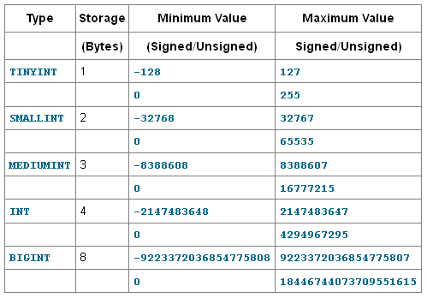
Integers
Attributes of integers
Can be SIGNED or UNSIGNED
ZEROFILL – padded on the left up to the maximum display size
Display Size – can give a size to integer data types – this does not change how the numbers are stored, but dictates how they will be displayed.
Types of Integers:
INT – 4 bytes of storage (most common)
BIGINT – 8 bytes of storage
MEDIUMINT – 3 bytes of storage
SMALLINT – 2 bytes of storage
TINYINT – 1 byte of storage

Slide 8
Real Numbers
Types of Real Numbers:
DECIMAL – fixed number of digits to the right of the decimal point
Syntax DECIMAL(m, d)
m – its precision or total number of digits
d – its scale or total number of digits to the right of the decimal point
Floating Point (be wary because of rounding – for very large/small numbers)
DOUBLE – single-precision number – up to 7 significant digits
FLOAT – double-precision number – up to 15 significant digits

Slide 9
Date/Time
DATE yyyy-mm-dd
TIME hh:mm:ss
DATETIME yyyy-mm-dd hh:mm:ss
TIMESTAMP yyyy-mm-dd hh:mm:ss
Updates automatically when the row is inserted or deleted (only the first occurrence)
Can only store up to year 2038
YEAR[ ( 2 | 4 ) ] yy or yyyy

Slide 10
Date/Time Interpretation

Slide 11
Other Data Types
ENUM – a string value chosen from a list of permitted values
enum_name ENUM(‘Orange’, ‘Blue’, ‘Neither’) not null default ‘Neither’
or default can be the First value in the list if not specified
SET – string value(s) from a list of permitted values
set_field SET('Ski', 'Snorkel', 'Dance', 'Travel') not null
LOB – Large Object Types
BLOB – Binary Large Object Type (images, sounds, video)
TEXT – String of characters
Read about these to be familiar, we are not going to be using

Slide 12
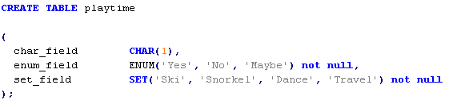
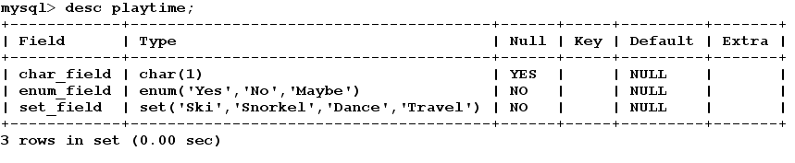
Other Data Types

Slide 13
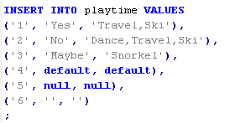
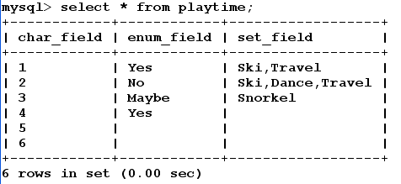
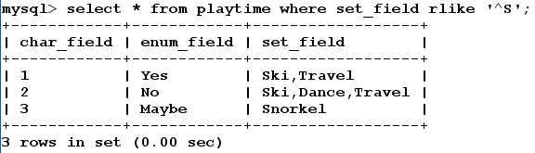
Other Data Types

Slide 14
Data Conversion
Implicit – happens automatically such as when you use data types in an expression or function and MySQL must convert values to the same data type in order to accomplish the task.
Explicit – when you want to control how a conversion is performed

Slide 15
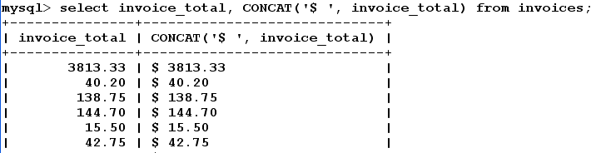
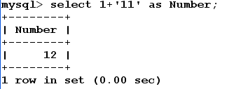
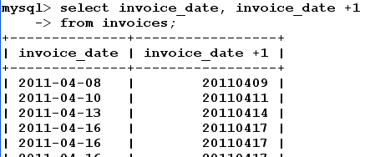
Implicit Data Conversion
Number to String
String to Number ● Date to Number

Slide 16
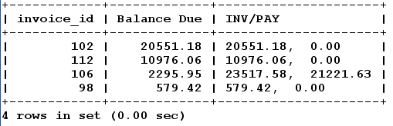
Explicit Data Conversion w/functions
CAST
SELECT invoice_id, invoice_total – payment_total as ‘Balance Due’,
CONCAT(CAST(invoice_total as CHAR), ‘, ‘,
CAST(payment_total as CHAR)) as ‘INV/PAY’
FROM invoices
ORDER BY invoice_total – payment_total DESC LIMIT 4;

Slide 17
Explicit Data Conversion w/functions
CONVERT – syntax slightly different from CAST
SELECT invoice_id, invoice_total – payment_total as ‘Balance Due’,
CONCAT(CONVERT(invoice_total, CHAR(10) ), ‘, ‘,
CONVERT(payment_total, CHAR(10) ) ) as ‘INV/PAY’
FROM invoices
ORDER BY invoice_total – payment_total DESC LIMIT 4;

Slide 18
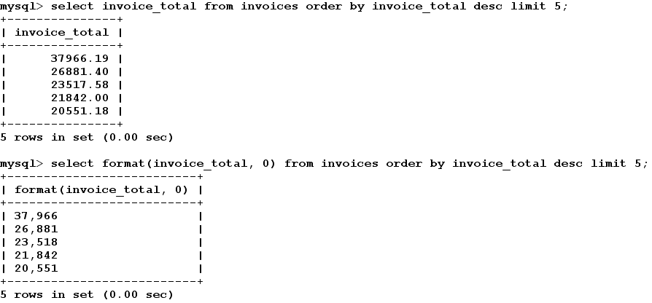
Explicit Data Conversion w/functions
FORMAT – converts a number to a string of characters, inserts commas and specifies number of decimal places

Slide 19
Explicit Data Conversion w/functions
CHAR – returns a binary string for each integer, typically used to out put ASCII control characters that can’t be typed on the keyboard
CHAR(9) Tab
CHAR(10) Line Feed
CHAR(13) Carriage Return

Slide 20
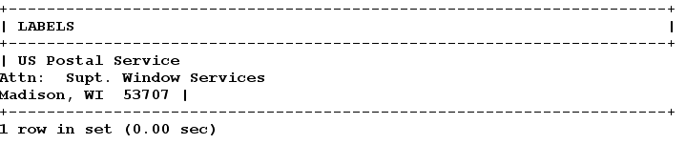
Explicit Data Conversion w/functions
select vendor_name, vendor_address1, vendor_city, vendor_state, vendor_zip_code from vendors limit 1;
select CONCAT(vendor_name, CHAR(10,13), vendor_address1, CHAR(10,13), vendor_city, ', ', vendor_state, ' ', vendor_zip_code) as LABELS
from vendors limit 1;

